Slide 1
SQL Server map tiles
November 1st Summary
Peter Hambly, SAHSU

Slide 2
Test case
US to county level:
56 states or territories (Guam, Puerto Rico etc.);
3,233 counties;
Zoomlevel 6 to 11 support;
1,050,102 possible map tiles at zoomlevel 11 for each of US nation, state and county level;
25% of all possible map tiles;
Take 80 minutes!

Slide 3
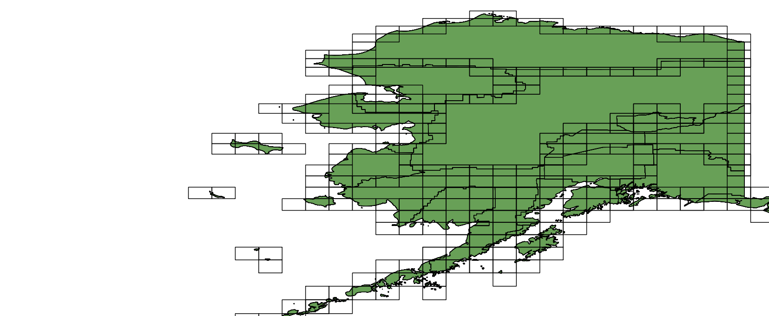
Example: Alaska counties, zoomlevel 8 Only tiles containing information are created

Slide 4
New efficient tile intersect algorithm
Zoomlevel | Xmin | Ymin | Xmax | Ymax | Possible tiles | Actual tiles | % saving
0 | 0 | 0 | 0 | 0 | 1 | 1 | 0.00
1 | 0 | 0 | 1 | 1 | 4 | 3 | 25.00
2 | 0 | 0 | 3 | 2 | 12 | 5 | 58.33
3 | 0 | 1 | 7 | 4 | 32 | 10 | 68.75
4 | 0 | 3 | 15 | 8 | 96 | 22 | 77.08
5 | 0 | 6 | 31 | 17 | 384 | 46 | 88.02
6 | 0 | 13 | 63 | 29 | 1088 | 112 | 89.71
7 | 0 | 27 | 127 | 59 | 4224 | 338 | 92.00
8 | 0 | 54 | 255 | 118 | 16640 | 1139 | 93.16
9 | 1 | 108 | 511 | 237 | 66430 | 4093 | 93.84
10 | 2 | 217 | 1023 | 474 | 263676 | 15308 | 94.19
11 | 4 | 435 | 2046 | 948 | 1050102 | 58968 | 94.38

Slide 5
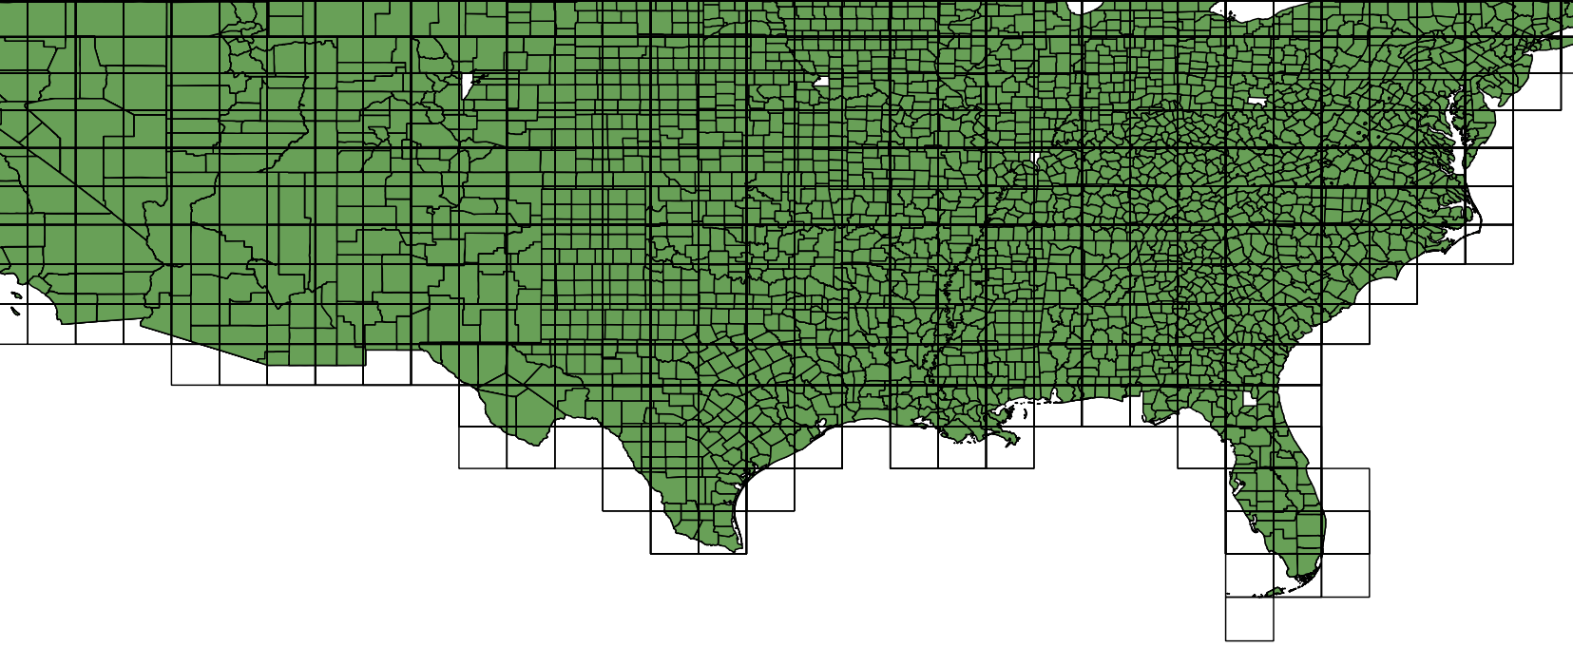
Southern US counties at zoomlevel 8

Slide 6
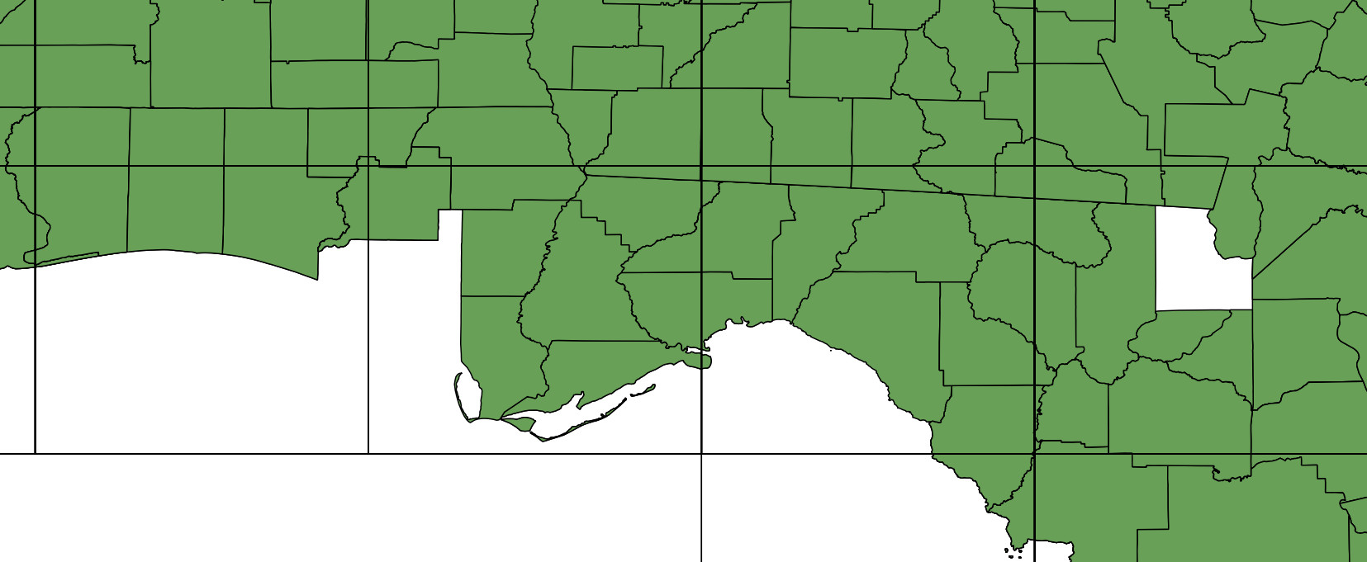
Southern US – missing tiles

Slide 7
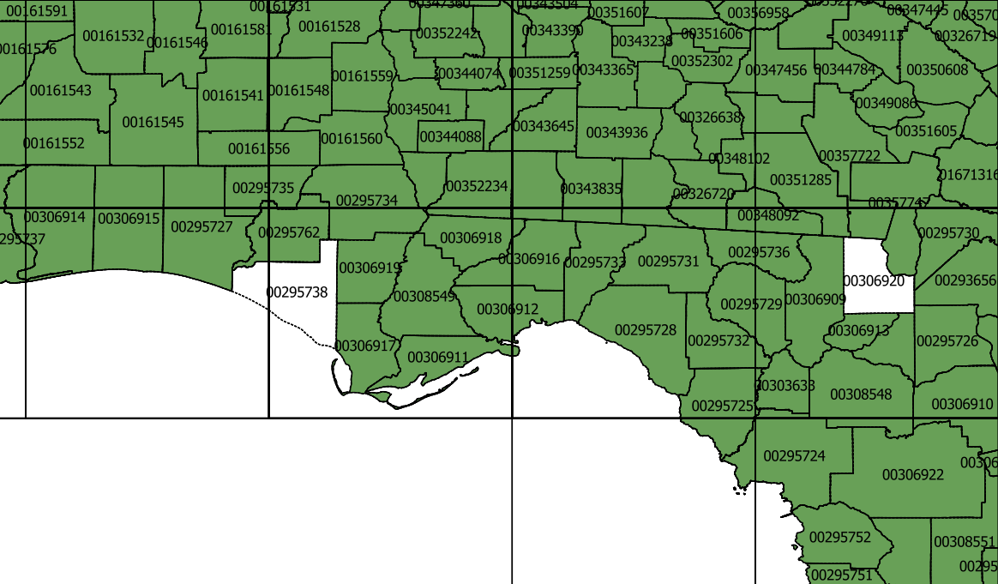
Add back missing tile area IDs and borders from Postgres

Slide 8
Missing tiles - summary
Tiles are in the database and are valid, appears to be a bug with QGIS which is complaining of broken polygons:
Exception: IllegalArgumentException: Invalid number of points in LinearRing found 3 - must be 0 or >= 4;
Technically these are triangles, and will be small islands that have been oversimplified (and almost certainly invisible at this scale). PostGIS will have removed them when cleaning the polygons;
Highlights the problems of standards for GIS, QGIS uses the same library as Postgres/PostGIS (GeOS); SQL Server is more relaxed;
Will convert to topoJSON with no problems;
Probably can fix in Node.js if needed.

Slide 9
To do
Fix the performance problem in SQL Server tile intersections:
Convert tile data to topoJSON in node.js then update tile table (a prototype already exists);
Add data to RIF (SQL Server then Postgres);
Zoomlevel | PostGIS | SQL Server
7 | 75 secs | 393 secs
8 | 166 secs | 27 mins
9 | 8 mins
10 | 24 mins
11 | 80 mins | Estimated at 15 hours!

